Slide 1
Using i in For Loops
Notes:
Hi, in this video we’re going to learn about the value of i in For Loops and how we can use it to control our programs.

Slide 2
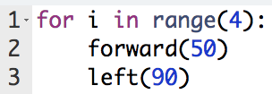
For Loops Refresher
For loops allow us to repeat code a specific amount of times.
Notes:
It’s been awhile since we learned about for loops so let’s review what a for loop is used for. A for loop allows us to repeat code a certain number of times. We’ve seen this code many times before. This loop tells Tracy to draw a square with sides of length 50.

Slide 3
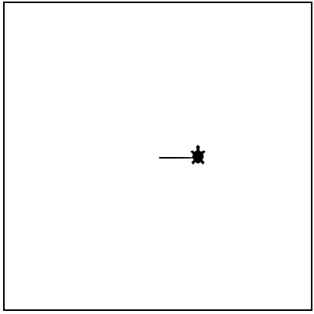
Counting Loops
i is changing its value on every iteration.
i = 0
Notes:
So what is actually happening when we run this loop? Well, the letter i is a variable in our code! i is starting at 0 and increasing by 1 every time the loop repeats until it hits the value of 4 and ending our loop.
So i starts at 0, (Click for green arrows) then the code indented below runs.

Slide 4
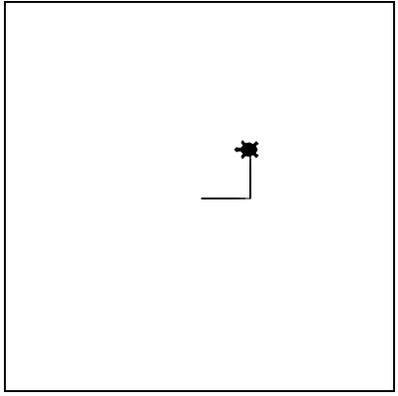
Counting Loops
i is changing its value on every iteration.
i = 1
Notes:
Then our loop goes back to the top and i increases by 1, so i is now equal to 1.
(Click for green arrows) Then our code below runs again.

Slide 5
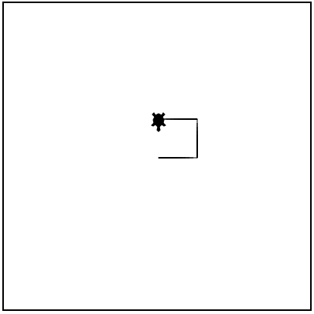
Counting Loops
i is changing its value on every iteration.
i = 2
Notes:
Our loop goes back to the top and i increases by 1, so i is now equal to 2.
(Click for green arrows) Then our code below runs again.

Slide 6
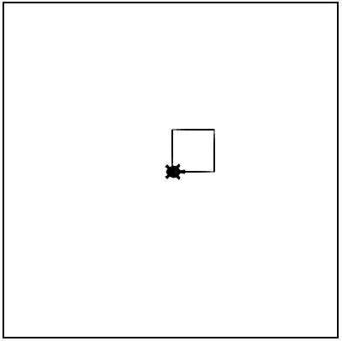
Counting Loops
i is changing its value on every iteration.
i = 3
Notes:
Our loop goes back to the top again and i increases by 1, so i is now equal to 3.
(Click for green arrows) Then our code below runs again.

Slide 7
Counting Loops
i is changing its value on every iteration.
i = 4
Notes:
Our loop then goes back to the top and increases by 1, so i is now equal to 4.
(Click for green arrows) 4 was the value we told our loop to stop at, so the loop is completed and the program runs the code after the loop.
Let’s take a look at a Tracy example to see how we can use the value of i in our programs.

Slide 8
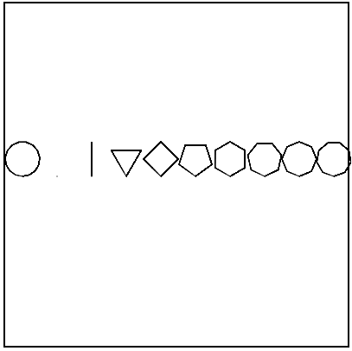
Example #1: Geometry
Write a program that has Tracy draw 10 shapes, from 0 points to 9 points. Align these shapes along the x-axis.
Notes:
This example is asking us to draw 9 shapes from 0 points (which is actually a circle) to 9 points which is a nonagon.

Slide 9
Commands Learned this Lesson
Command | What does it do?
for i in range(ending_num): | Creates a loop where the value of i is controlling the loop iterations
Notes:
In this lesson, we learned how to use the value of i in our for loops to control our code. Look back at the examples we completed to help you solve the next set of Tracy challenges!

